Slide 1
DATA ANALYTICS JOURNEY
Stop Copy-Pasting.
Start Automating.
How I built a 3-tier automated sales tracking system in Google Sheets using custom macros to eliminate repetitive manual work.
Form
Database
Dashboard

Slide 2
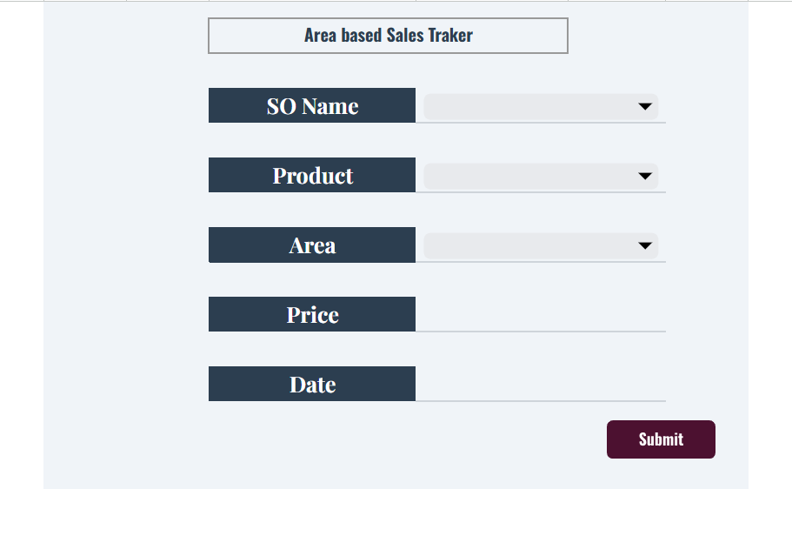
Guarding Data Quality at the Source
The easiest way to fix dirty data is to prevent it from entering the system. I built a dedicated data entry interface complete with strict validation drop-downs.
The Form
Controlled input layer for field operators, almost every entry is guided and validated.

Slide 3
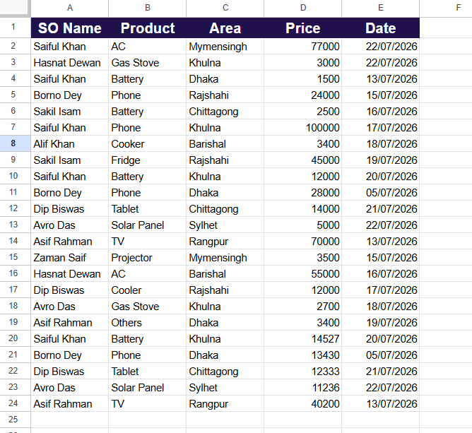
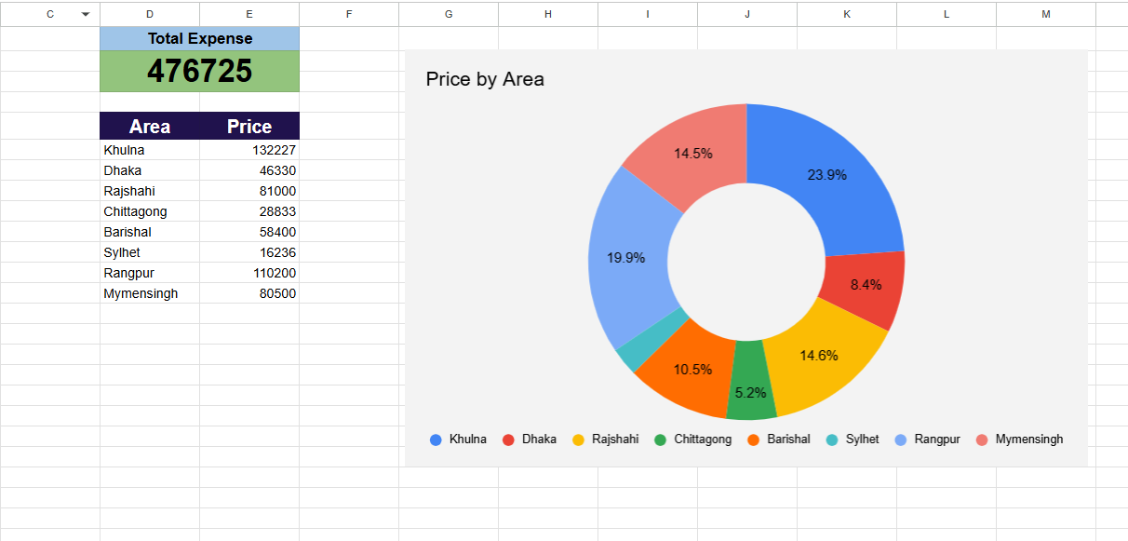
The Database
Automated storage layer that runs quietly in the background, out of reach of manual edits.
The Dashboard
Live visualization layer built for management decision-making, in real time.

Slide 4
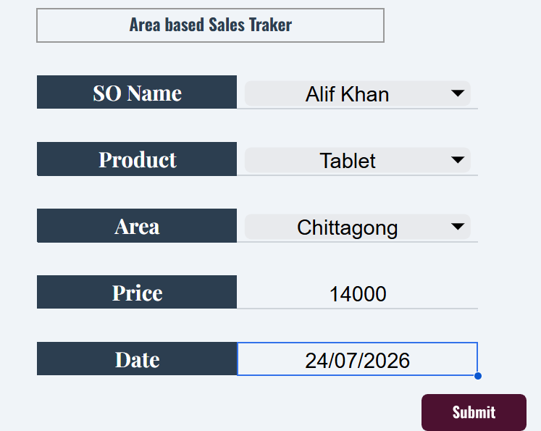
Entering Live Field Transactions
A Sales Officer fills out the form with a new entry: Alif Khan closes a Tablet sale in Chittagong valued at 14,000. Instead of manually finding the next blank row in a master sheet, they simply hit Submit.

Slide 5
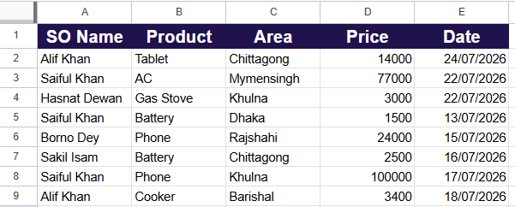
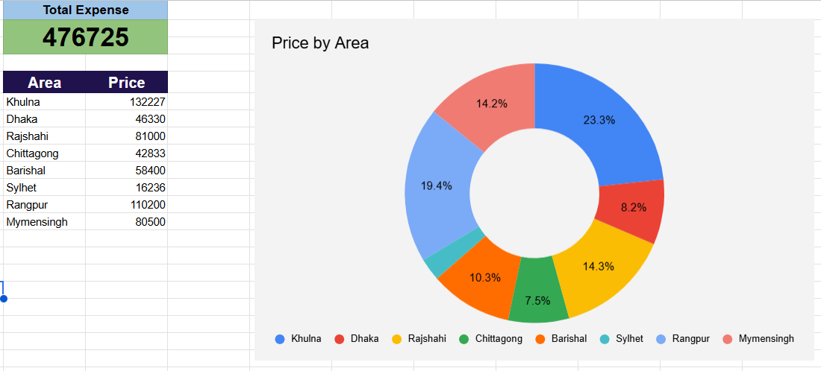
Automated Sorting & Recalculation
The macro fires instantly! It pushes the record into the master database at the top row while the dashboard updates the Chittagong metric to 42,833, scaling its chart slice up to 7.5%.

Slide 6
The Operational Impact of Automation
Zero Data Corruption
Field users never touch master formulas or database rows directly.
Time Savings
Eliminates manual copying, pasting, sorting, and structural formatting.
Real-Time Visibility
Management metrics adjust instantly with every mouse click.

